Slide 1
Skeletal Outline:
Informative Speech
Bruce G. Bryski
Bryski/Brown (6th ed)
Page 211

Slide 2
I. Introduction:
I. Introduction
A. Speaker Introduction and audience salutation (self introduction and audience greeting)
B. Attention-getter (attention-getting device) to catch and maintain the audience’s attention
    Refer directly to the topic or the occasion of the speech
    Use a personal story, experience, or reference
    Ask a “rhetorical question” to your audience
    Make a startling statement of fact or opinion
    Use a detailed example or illustration
    Ask for audience participation or feedback
    Use a direct quotation
    Tell a humorous story, joke, or anecdote

Slide 3
Outline Introduction (continued):
C. Credibility/ethos (ethos statement); speaker qualifications, expertise, training, and experience with the topic
D. Rationale/common ground (significance of the topic for the audience; reasons for listening and “audience payoff”)
E. Thesis statement (major point, idea, and assertion made by the speaker and central theme of the speech

Slide 4
II. Body (discussion section)
A. Initial summary or preview (preview the major areas to be discussed or covered during the speech)
B. Evidence and support material
C. Definition of terms
D. Transition statement

Slide 5
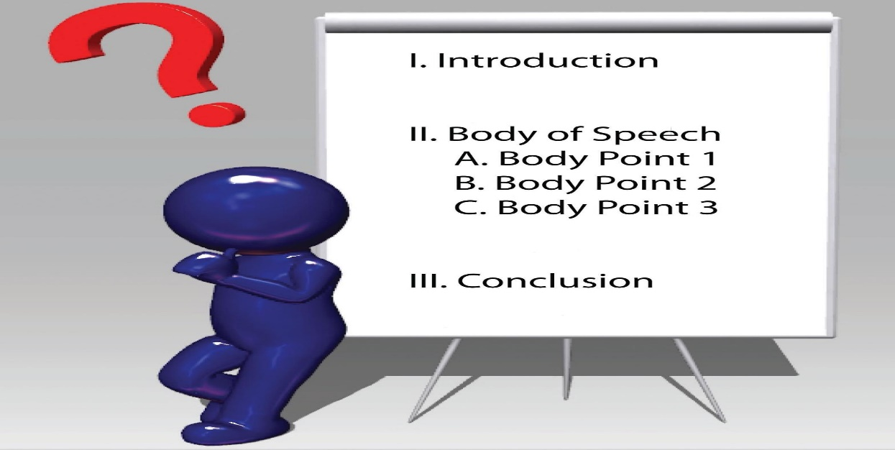
III. Conclusion (summary statement)
A. Review or summary statement (review or summarize the major areas covered during the speech)
B. Final rationale (reinforce message; the bottom line; audience payoff and benefits)
This Photo by Unknown Author is licensed under CC BY-SA-NC

Slide 6
Sample Informative Speech (pp.212-213)
(Jogging for Fitness and Fun) by Joe E. Jock
I. Introduction
*A. Speaker Introduction and audience salutation
*B. Attention-getting device
“Good morning. My name is Joe E. Jock. I want to welcome you today.”
“How many of you would like to get in shape, reduce the risk of heart attack, lose weight, exercise two to three times a week, and meet new people?”

Slide 7
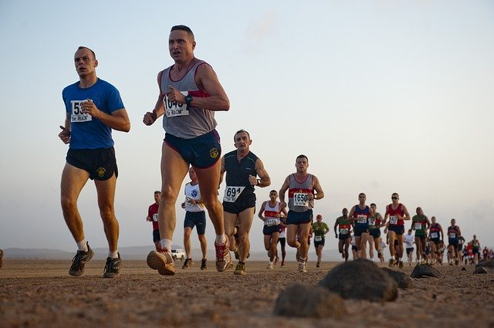
Sample Speech (continued):
*C. Ethos statement (speaker credibility)
“I’ve been jogging for ten years now, ran on my track team in high school, and have run competitively in several 5- kilometer and 10-kilometer races. I am currently training for my first ‘marathon’ next year, a 26-mile race.”

Slide 8
Sample Speech (continued):
D. Rationale (benefits and significance of the topic; audience payoff)
“I have found that jogging promotes a healthy lifestyle by maintaining a healthy weight. In addition, jogging decreases the risk of heart attack and high blood pressure. Moreover, jogging enables you to meet other people with similar interests and it gives you a sense of accomplishment.”

Slide 9
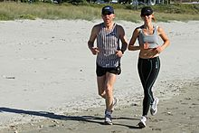
Sample Speech (continued):
E. Thesis (major point, idea, and assertion made by the speaker)
“While there are many benefits to jogging, several important steps need to be taken into consideration before you can receive the benefits of running. These crucial aspects will assure you that your jogging will be safe and effective.”
This Photo by Unknown Author is licensed under CC BY-SA

Slide 10
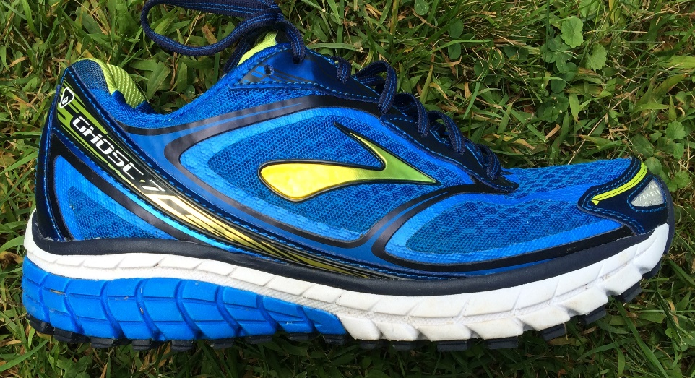
II. Body (discussion section):
“In discussing jogging as a popular form of aerobic exercise, there are three important considerations for the beginning runner. How to select the proper running shoe, the importance of stretching or warm-up exercises, and how to develop you own jogging program are all important considerations.”
A. Initial summary/Preview
This Photo by Unknown Author is licensed under CC BY-SA-NC

Slide 11

Body (continued):
B. Detailed discussion of the three or four major areas to be covered
1. Selecting the proper running shoe to meet your personal needs as a runner
2. The importance of warm-up and stretching exercises
3. How to develop your own jogging program and chart your personal accomplishments as a runner
This Photo by Unknown Author is licensed under CC BY

Slide 12
Body (continued):
C. Definition of terms
*Make sure you define and explain any terms or vocabulary and terminology associated with your subject (jogging)
1. “Runner’s knee”
2. “Hitting the wall”
3. “Aerobic exercise”
4. “Cool-down period”

Slide 13

Body (continued):
D. Evidence and support material (the body of the speech should include any research, evidence, and support material such as statistical evidence, detailed example or illustration, expert testimony, etc.)
This Photo by Unknown Author is licensed under CC BY-SA-NC

Slide 14
Body (continued):
“Now that I’ve discussed how to select the proper running shoe to meet your personal needs as a runner, and the importance of stretching or warm-up exercises to prevent leg cramps and damage to your muscles, I’d like to conclude by talking about how to develop your own jogging program . . .”
E. Transition statement (provides a review of the areas already covered, and a preview of the final area you will discuss)

Slide 15
III. Conclusion
“Today I have talked about jogging as a popular form of aerobic exercise. I have discussed how selecting the proper shoe to meet your personal needs as a runner, the importance of stretching or warm-up exercises, and developing your own jogging program, are all very important considerations for anyone interested in jogging for fitness and fun.”
Summary statement (provides a brief and concise review of the major areas covered during the speech)

Slide 16
III. Conclusion (continued):
Final rationale (reinforce the significance and importance of the topic for the audience one last time)
“I have found, and I know you will discover, that jogging makes me feel good about myself. It will allow you to look and feel better, and be a healthier, happier individual, while achieving a sense of personal accomplishment.”
“Thank you. Are there any comments or questions?”

